Slide 1

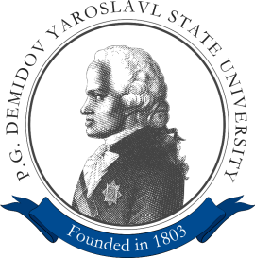
Facial Expression Recognition Algorithm Based on Deep Convolution Neural Network`
Leonid Ivanovsky
Vladimir Khryashchev
Anton Lebedev

Slide 2
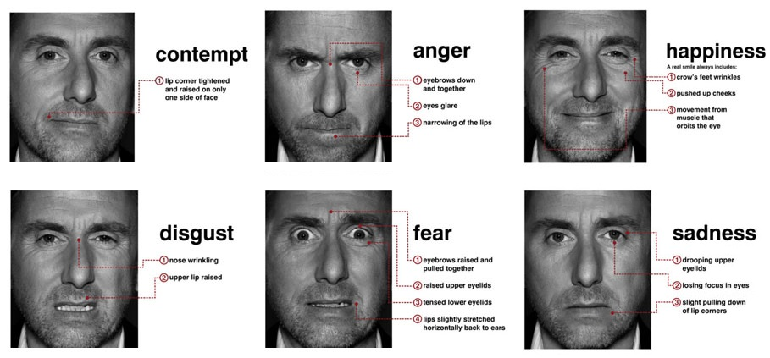
Purpose
Development of algorithm of facial expression recognition and smile detection on face image based on deep convolutional neural network

Slide 3

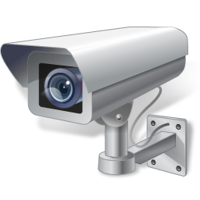

Usability
Lie detectors
(clinical psychology, psychiatry)
Video analytics
(front office staff performance, security systems)
Retail
(entertainment services)

Slide 4



Development tools

Slide 5
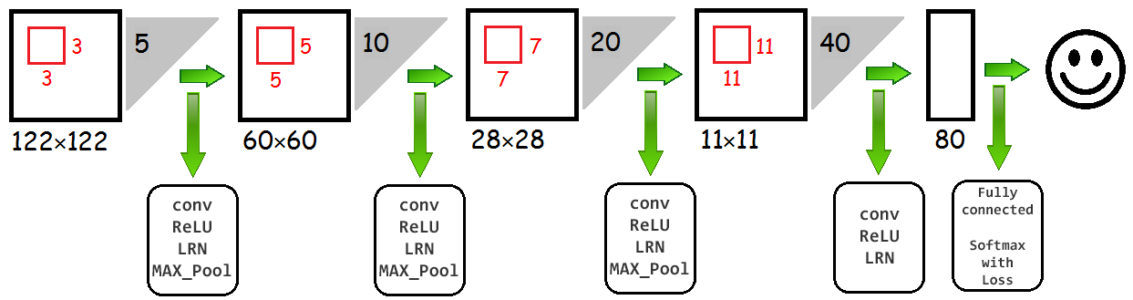
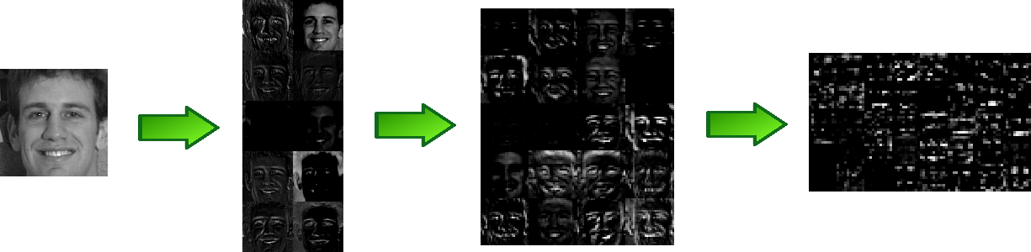
Developed convolutional neural network

Slide 6
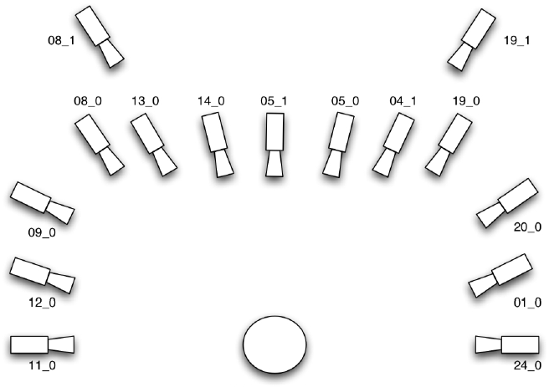
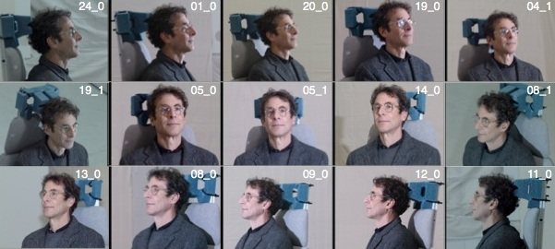
Multi-PIE Face Database
http://www.cs.cmu.edu/afs/cs/project/PIE/MultiPie/Multi-Pie/Home.html

Slide 7
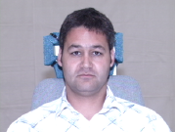
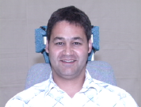
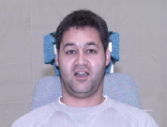
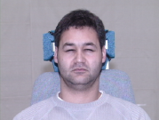
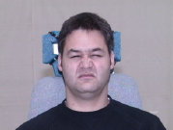
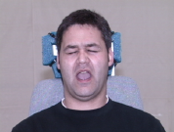
Classes of facial expression
a) Neutral
b) Smile
c) Surprised
d) Squint
e) Disguist
f) Scream
http://www.cs.cmu.edu/afs/cs/project/PIE/MultiPie/Multi-Pie/Home.html

Slide 8
Sampling
30000 randomly selected images
Labelling: 6 classes for facial emotion recognition,
2 classes for smile detection
Angle of view: [-45, 45]
Train and test samples: 80/20

Slide 9
Results
Problem | Accuracy
Facial Expression Recognition | 85.83%
Smile Detection | 95.69%

Slide 10
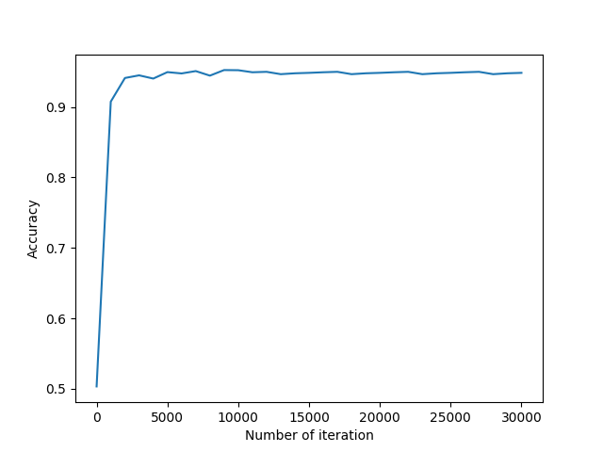
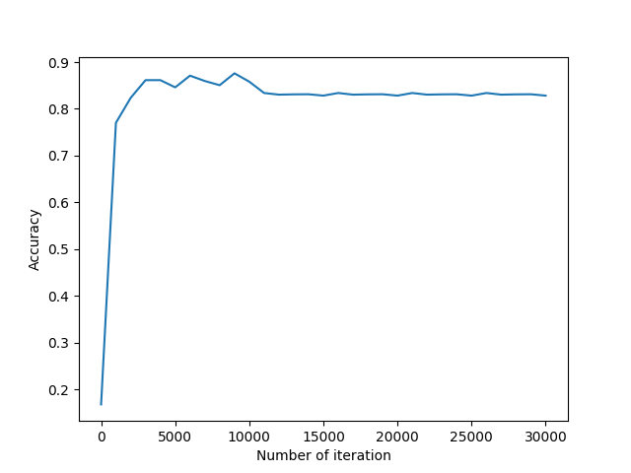
Accuracy
a) Smile detection
b) Facial expression recognition

Slide 11
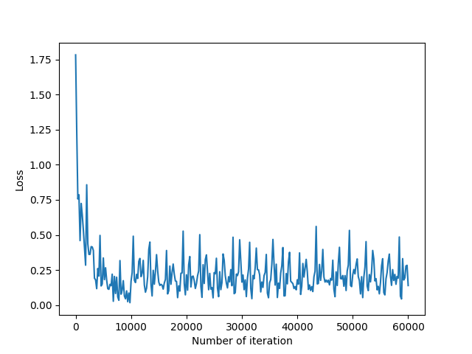
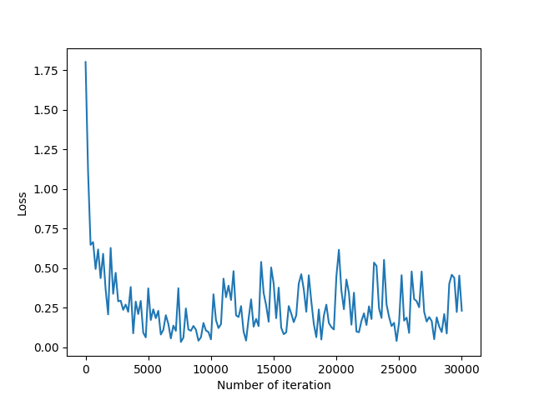
Loss history
a) Smile detection
b) Facial expression recognition

Slide 12
Smile detection
Classes |  | Real class
 |  | Smile | Non-smile
Predicted class | Smile | 2879 | 178
 | Non-smile | 121 | 2822
Error analysis |  | Metrics
 |  | Precision | Recall | F-score
Classes | Smile | 0,96 | 0,94 | 0,95
 | Non-smile | 0,94 | 0,96 | 0,95

Slide 13
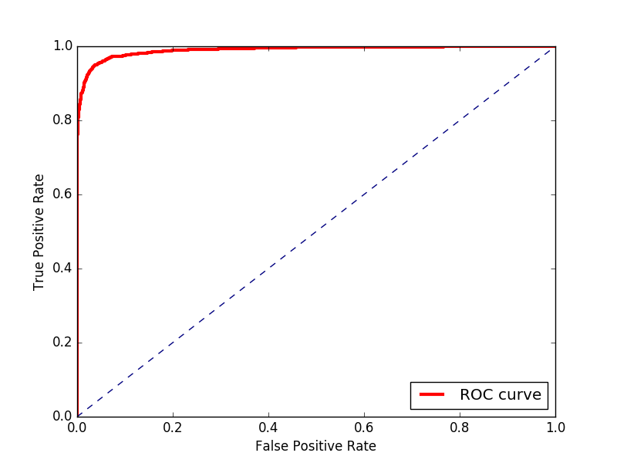
Smile detection
AUC-ROC: 0,98

Slide 14
Facial expression recognition
Classes |  | Real class
 |  | Smile | Surprise | Disgust | Squint | Scream | Neutral
Predicted class | Smile | 894 | 14 | 35 | 46 | 2 | 54
 | Surprise | 36 | 954 | 0 | 1 | 14 | 12
 | Disgust | 9 | 0 | 701 | 155 | 3 | 9
 | Squint | 18 | 4 | 191 | 723 | 4 | 23
 | Scream | 8 | 21 | 25 | 14 | 976 | 0
 | Neutral | 35 | 7 | 48 | 61 | 1 | 902

Slide 15
Facial expression recognition
Error analysis |  | Metrics
 |  | Precision | Recall | F-score
Classes | Smile | 0,89 | 0,86 | 0,87
 | Surprise | 0,95 | 0,94 | 0,94
 | Disgust | 0,7 | 0,8 | 0,75
 | Squint | 0,72 | 0,75 | 0,73
 | Scream | 0,98 | 0,93 | 0,95
 | Neutral | 0,9 | 0,86 | 0,88

Slide 16
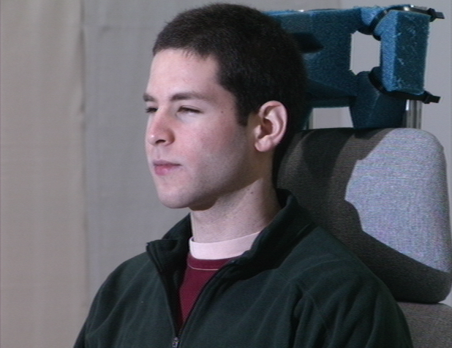
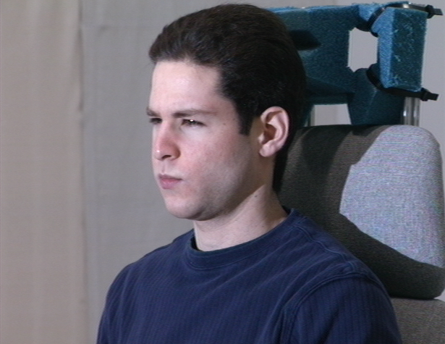
Distinguishable facial expressions
a) Squint
b) Disguist

Slide 17
Facial Expression Recognition Algorithm Based on Deep Convolution Neural Network`
Leonid Ivanovsky
Vladimir Khryaschev
Anton Lebedev

